Slide 1
15장: 동시성 제어

Slide 2
Topics
Lock-Based Protocols
Timestamp-Based Protocols
Validation-Based Protocols
Multiple Granularity
Multiversion Schemes
Insert and Delete Operations
Concurrency in Index Structures

Slide 3
Lock-Based Protocols: 락 기반 규약
A lock is a mechanism to control concurrent access to a data item
Data items can be locked in two modes:
1. exclusive (X) mode: 독점적 락 모드
Data item can be both read as well as written.
X-lock is requested using lock-X instruction.
2. shared (S) mode: 공유 락 모드
Data item can only be read.
S-lock is requested using lock-S instruction.
Lock requests are made to concurrency-control manager.
  Transaction can proceed only after request is granted.

Slide 4
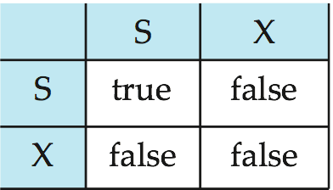
Lock-Based Protocols: 락 기반 규약
Lock-compatibility matrix: 락 호환성 행렬
A transaction may be granted a lock on an item if the requested lock is compatible with locks already held on the item by other transactions.
Any number of transactions can hold shared locks on an item,
But, if any transaction holds an exclusive on the item no other transaction may hold any lock on the item.
If a lock cannot be granted, the requesting transaction is made to wait till all incompatible locks held by other transactions have been released. The lock is then granted.

Slide 5
Lock-Based Protocols: 락 기반 규약
Example of a transaction performing locking:
T₂: lock-S(A);
read (A);
unlock(A);
lock-S(B);
read (B);
unlock(B);
display(A+B)
Locking as above is not sufficient to guarantee serializability(직렬성)
  If A and B get updated in-between the read of A and B, the displayed sum would be wrong.
A locking protocol is a set of rules followed by all transactions while requesting and releasing locks.
  Locking protocols restrict the set of possible schedules.

Slide 6

Pitfalls of Lock-Based Protocols
Consider the partial schedule
Neither T₃ nor T₄ can make progress — executing lock-S(B) causes T₄ to wait for T₃ to release its lock on B, while executing lock-X(A) causes T₃ to wait for T₄ to release its lock on A.
Such a situation is called a deadlock(교착).
  To handle a deadlock, one of T₃ or T₄ must be rolled back
  and its locks released.

Slide 7
Pitfalls of Lock-Based Protocols (Cont.)
The potential for deadlock exists in most locking protocols.
  Deadlocks are a necessary evil.
Starvation(기아) is also possible if concurrency control manager is badly designed. For example:
  A transaction may be waiting for an X-lock on an item, while a sequence of other transactions request and are granted an S-lock on the same item.
  The same transaction is repeatedly rolled back due to deadlocks.
Concurrency control manager can be designed to prevent starvation.

Slide 8
The Two-Phase Locking Protocol: 2단계 락킹 규약
This is a protocol which ensures conflict-serializable schedules.
Phase 1: Growing Phase(증가 단계)
  transaction may obtain locks
  transaction may not release locks
Phase 2: Shrinking Phase(감소 단계)
  transaction may release locks
  transaction may not obtain locks
The protocol assures serializability.
  It can be proved that the transactions can be serialized in the order of their lock points(락 지점) (i.e., the point where a transaction acquired its final lock).

Slide 9
The Two-Phase Locking Protocol (Cont.)
Two-phase locking does not ensure freedom from deadlocks.
Cascading roll-back is possible under two-phase locking.
To avoid this, follow a modified protocol called strict two-phase locking(strict 2단계 락킹).
  Here a transaction must hold all its exclusive locks till it commits/aborts.
Rigorous two-phase locking(Rigorous 2단계 락킹) is even stricter
  Here all locks are held till commit/abort.
  In this protocol transactions can be serialized in the order in which they commit.

Slide 10
Acquisition of Lock for read(D)
A transaction T_{i} issues the standard read/write instruction, without explicit locking calls.
The operation read(D) is processed as:
if T_{i} has a lock on D
then
read(D)
else begin
if necessary, wait until no other transaction has a lock-X on D
grant T_{i} a lock-S on D;
read(D)
end

Slide 11
Acquisition of Lock for write(D)
write(D) is processed as:
if T_{i} has a lock-X on D
then
write(D)
else begin
if necessary, wait until no other transaction has any lock on D,
if T_{i} has a lock-S on D
then
upgrade lock on D to lock-X
else
grant T_{i} a lock-X on D
write(D)
end;
All locks are released after commit or abort

Slide 12
Implementation of Locking
A lock manager(락 관리자) can be implemented as a separate process to which transactions send lock and unlock requests.
The lock manager replies to a lock request by sending
  a lock grant messages
  or a message asking the transaction to roll back, in case of a deadlock.
The requesting transaction waits until its request is answered.
The lock manager maintains a data-structure called a lock table
  To record granted locks and pending requests.
  The lock table is usually implemented as an in-memory hash table indexed on the name of the data item being locked.

Slide 13
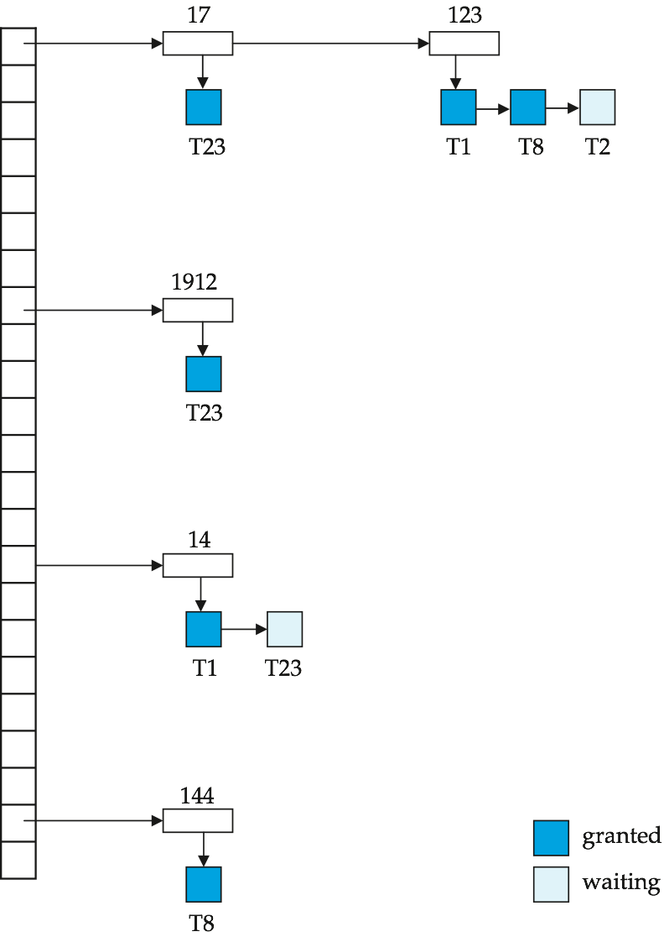
Lock Table
Blue rectangles indicate granted locks, white ones indicate waiting requests
Lock table also records the type of lock granted or requested
New request is added to the end of the queue of requests for the data item, and granted if it is compatible with all earlier locks
Unlock requests result in the request being deleted, and later requests are checked to see if they can now be granted
If transaction aborts, all waiting or granted requests of the transaction are deleted
  Lock manager may keep a list of locks held by each transaction, to implement this efficiently

Slide 14

Deadlock Handling
Consider the following two transactions:
T₁: write (X) T₂: write(Y)
write(Y) write(X)
Schedule with deadlock

Slide 15
Deadlock Handling: 교착상태 처리
System is deadlocked if there is a set of transactions such that every transaction in the set is waiting for another transaction in the set.
Deadlock prevention(교착상태 예방) protocols ensure that the system will never enter into a deadlock state. Some prevention strategies:
  Require that each transaction locks all its data items before it begins execution (predeclaration).
  Impose partial ordering of all data items and require that a transaction can lock data items only in the order specified by the partial order

Slide 16
More Deadlock Prevention Strategies
Following schemes use transaction timestamps for the sake of deadlock prevention alone.
wait-die scheme
  Older transaction may wait for younger one to release data item.
  Younger transactions never wait for older ones; they are rolled back instead.
    A transaction may die several times before acquiring needed data item
wound-wait scheme
  Older transaction wounds (forces rollback) of younger transaction instead of waiting for it. Younger transactions may wait for older ones.
  May be fewer rollbacks than wait-die scheme
Write(x)
Wait
Read(y)
Old
Read(x)
Write(y)
Die
Young
Write(x)
Read(y)
Old
Read(x)
Die
Write(y)
Wait
Young

Slide 17
Deadlock prevention (Cont.)
Timeout-Based Schemes:
  a transaction waits for a lock only for a specified amount of time. After that, the wait times out and the transaction is rolled back.
  Thus deadlocks are not possible
  Simple to implement; but starvation is possible.
  Difficult to determine good value of the timeout interval.

Slide 18
Deadlock Detection: 교착상태 탐지
Deadlocks can be described as a wait-for graph(대기 그래프), which consists of a pair G = (V,E),
  V is a set of vertices (all the transactions in the system)
  E is a set of edges; each element is an ordered pair T_{i} →T_{j}.
If T_{i} → T_{j} is in E, then there is a directed edge from T_{i} to T_{j}, implying that T_{i} is waiting for T_{j} to release a data item.
When T_{i} requests a data item currently being held by T_{j}, then the edge T_{i} → T_{j} is inserted in the wait-for graph. This edge is removed only when T_{j} is no longer holding a data item needed by T_{i}.
The system is in a deadlock state if and only if the wait-for graph has a cycle. Must invoke a deadlock-detection algorithm periodically to look for cycles.

Slide 19
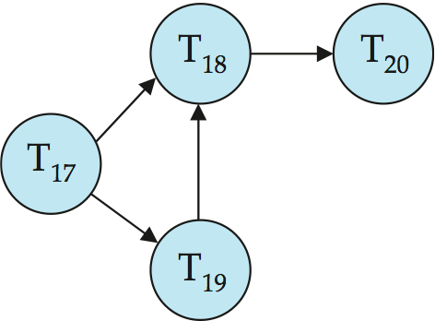
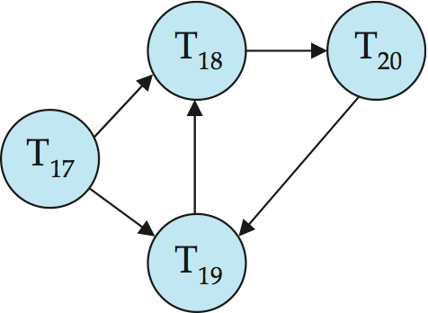
Deadlock Detection (Cont.)
Wait-for graph without a cycle
Wait-for graph with a cycle

Slide 20
Deadlock Recovery: 교착 상태로부터의 복구
When deadlock is detected:
  Some transaction will have to be rolled back (made a victim) to break deadlock.
    Select that transaction as victim that will incur minimum cost.
  Rollback -- determine how far to roll back transaction
    Total rollback: Abort the transaction and then restart it.
    More effective to roll back transaction only as far as necessary to break deadlock.
  Starvation happens if same transaction is always chosen as victim.
    Include the number of rollbacks in the cost factor to avoid starvation

Slide 21
Multiple Granularity: 다중 세분도
Allow data items to be of various sizes and define a hierarchy of data granularities, where the small granularities are nested within larger ones.
Can be represented graphically as a tree
When a transaction locks a node in the tree explicitly, it implicitly locks all the node's descendents in the same mode.
  Explicit lock: 명시적인 락
  Implicit lock: 암묵적인 락
Granularity of locking (level in tree where locking is done):
  Fine granularity (lower in tree): high concurrency, high locking overhead
  Coarse granularity (higher in tree): low locking overhead, low concurrency

Slide 22
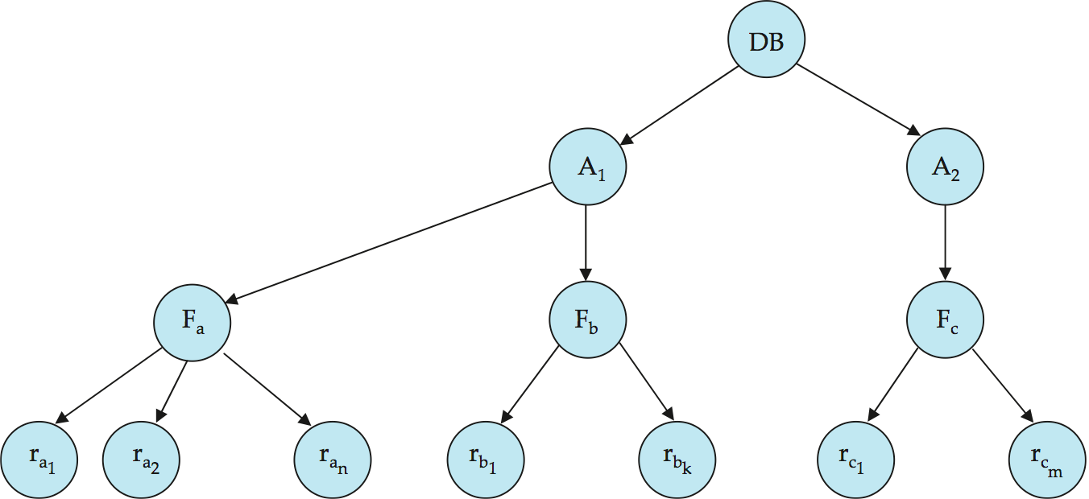
Example of Granularity Hierarchy: 세분도 계층구조
The levels, starting from the coarsest (top) level are:
  database
  area
  file
  record

Slide 23
Intention Lock Modes: 의도 락 모드
In addition to S and X lock modes, there are three additional lock modes with multiple granularity:
  intention-shared (IS): indicates explicit locking at a lower level of the tree but only with shared locks. ← 의도-공유 모드
  intention-exclusive (IX): indicates explicit locking at a lower level with exclusive or shared locks ← 의도-독점적 모드
  shared and intention-exclusive (SIX): the subtree rooted by that node is locked explicitly in shared mode and explicit locking is being done at a lower level with exclusive-mode locks. ← 공유와 의도-독점적 모드
Intention locks allow a higher level node to be locked in S or X mode without having to check all descendent nodes.

Slide 24
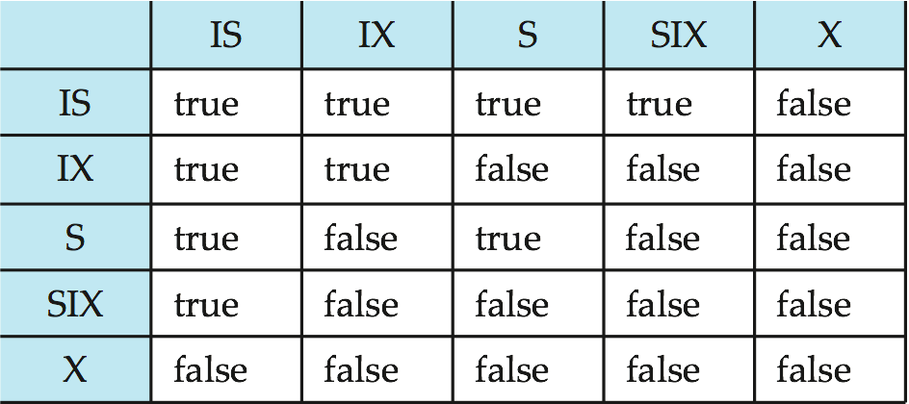
Compatibility Matrix with Intention Lock Modes
The compatibility matrix(호환성 행렬) for all lock modes is:

Slide 25
Multiple Granularity Locking Scheme: 다중 세분도 락킹 규약
Transaction T_{i} can lock a node Q, using the following rules:
  The lock compatibility matrix must be observed.
  The root of the tree must be locked first, and may be locked in any mode.
  A node Q can be locked by T_{i} in S or IS mode only if the parent of Q is currently locked by T_{i} in either IX or IS mode.
  A node Q can be locked by T_{i} in X, SIX, or IX mode only if the parent of Q is currently locked by T_{i} in either IX or SIX mode.
  T_{i} can lock a node only if it has not previously unlocked any node (that is, T_{i} is two-phase).
  T_{i} can unlock a node Q only if none of the children of Q are currently locked by T_{i}.
Observe that locks are acquired in root-to-leaf order, whereas they are released in leaf-to-root order.

Slide 26
Timestamp-Based Protocols: 타임스탬프 기반 규약
Each transaction is issued a timestamp when it enters the system.
If an old transaction T_{i} has time-stamp TS(T_{i}), a new transaction T_{j} is assigned time-stamp TS(T_{j}) such that TS(T_{i}) <TS(T_{j}).
The protocol manages concurrent execution such that the time-stamps determine the serializability order.
In order to assure such behavior, the protocol maintains for each data Q two timestamp values:
  W-timestamp(Q) is the largest time-stamp of any transaction that executed write(Q) successfully.
  R-timestamp(Q) is the largest time-stamp of any transaction that executed read(Q) successfully.

Slide 27
Timestamp-Based Protocols: 타임스탬프 기반 규약
The timestamp ordering protocol ensures that any conflicting read and write operations are executed in timestamp order.
Suppose a transaction T_{i} issues a read(Q):
  If TS(T_{i}) ≤ W-timestamp(Q), then T_{i} needs to read a value of Q that was already overwritten.
    Hence, the read operation is rejected, and T_{i} is rolled back.
  If TS(T_{i})≥ W-timestamp(Q), then the read operation is executed, and R-timestamp(Q) is set to max(R-timestamp(Q), TS(T_{i})).

Slide 28
Timestamp-Based Protocols: 타임스탬프 기반 규약
Suppose that transaction T_{i} issues write(Q).
  If TS(T_{i}) < R-timestamp(Q), then the value of Q that T_{i} is producing was needed previously, and the system assumed that that value would never be produced.
    Hence, the write operation is rejected, and T_{i} is rolled back.
  If TS(T_{i}) < W-timestamp(Q), then T_{i} is attempting to write an obsolete value of Q.
    Hence, this write operation is rejected, and T_{i} is rolled back.
  Otherwise, the write operation is executed, and W-timestamp(Q) is set to TS(T_{i}).

Slide 29

Example Use of the Protocol
A partial schedule for several data items for transactions with
timestamps 1, 2, 3, 4, 5

Slide 30

Correctness of Timestamp-Ordering Protocol
The timestamp-ordering protocol guarantees serializability since all the arcs in the precedence graph are of the form:
Thus, there will be no cycles in the precedence graph.
Timestamp protocol ensures freedom from deadlock as no transaction ever waits.
But the schedule may not be cascade-free, and may not even be recoverable.

Slide 31
Recoverability and Cascade Freedom
Problem with timestamp-ordering protocol:
  Suppose T_{i} aborts, but T_{j} has read a data item written by T_{i}
  Then T_{j} must abort; if T_{j} had been allowed to commit earlier, the schedule is not recoverable.
  Further, any transaction that has read a data item written by T_{j} must abort
  This can lead to cascading rollback --- that is, a chain of rollbacks
Solution 1:
  A transaction is structured such that its writes are all performed at the end of its processing
  All writes of a transaction form an atomic action; no transaction may execute while a transaction is being written
  A transaction that aborts is restarted with a new timestamp
Solution 2: Limited form of locking: wait for data to be committed before reading it
Solution 3: Use commit dependencies to ensure recoverability

Slide 32
Thomas’ Write Rule
Modified version of the timestamp-ordering protocol in which obsolete write operations may be ignored under certain circumstances.
When T_{i} attempts to write data item Q, if TS(T_{i}) < W-timestamp(Q), then T_{i} is attempting to write an obsolete value of {Q}.
  Rather than rolling back T_{i} as the timestamp ordering protocol would have done, this {write} operation can be ignored.
Otherwise this protocol is the same as the timestamp ordering protocol.
Thomas' Write Rule allows greater potential concurrency.
  Allows some view-serializable schedules that are not conflict-serializable.

Slide 33
Snapshot Isolation : 스탭샷 고립
Motivation: Decision support queries that read large amounts of data have concurrency conflicts with OLTP transactions that update a few rows
  Poor performance results
Solution 1: Give logical “snapshot” of database state to read only transactions, read-write transactions use normal locking
  Multiversion 2-phase locking
  Works well, but how does system know a transaction is read only?
Solution 2: Give snapshot of database state to every transaction, updates alone use 2-phase locking to guard against concurrent updates
  Problem: variety of anomalies such as lost update can result
  Partial solution: snapshot isolation level (next slide)
    Proposed by Berenson et al, SIGMOD 1995
    Variants implemented in many database systems
      E.g., Oracle, PostgreSQL, SQL Server 2005

Slide 34
Snapshot Isolation: 스탭샷 고립
A transaction T1 executing with Snapshot Isolation
  Takes snapshot of committed data at start
  Always reads/modifies data in its own snapshot
  Updates of concurrent transactions are not visible to T1
  Writes of T1 complete when it commits
  First-committer-wins rule:
    Commits only if no other concurrent transaction has already written data that T1 intends to write.
T1 | T2 | T3
W(Y := 1) Commit
 | Start R(X) → 0 R(Y)→ 1
 |  | W(X:=2) W(Z:=3) Commit
 | R(Z) → 0 R(Y) → 1 W(X:=3) Commit-Req Abort
Concurrent updates not visible
Own updates are visible
Not first-committer of X
Serialization error, T2 is rolled back

Slide 35
Benefits of SI
Reading is never blocked
  and also doesn’t block other transactions’ activities
Performance similar to Read Committed
Avoids the usual anomalies
  No dirty read
  No lost update
  No non-repeatable read
  Predicate based selects are repeatable (no phantoms)
Problems with SI
  SI does not always give serializable executions
    Serializable: among two concurrent transactions, one sees the effects of the other
    In SI: neither sees the effects of the other
  Result: Integrity constraints can be violated

Slide 36
Snapshot Isolation: 스탭샷 고립
E.g., of problem with SI
  T1: x:=y
  T2: y:= x
  Initially x = 3 and y = 17
    Serial execution: x = ??, y = ??
    if both transactions start at the same time, with snapshot isolation: x = ?? , y = ??
Called skew write
Skew also occurs with inserts
  E.g.,: 청구서 번호 부여하기
    2개 transaction이 동시에 새로운 청구서에 번호를 부여하고 있는 상황
    Find max order(청구서) number among all orders
    Create a new order with order number = previous max + 1

Slide 37
Snapshot Isolation Anomalies
SI breaks serializability when transactions modify different items, each based on a previous state of the item the other modified
  Not very common in practice
    E.g., the TPC-C benchmark runs correctly under SI
    when transactions conflict due to modifying different data, there is usually also a shared item they both modify too (like a total quantity) so SI will abort one of them
  But does occur
    Application developers should be careful about write skew
SI can also cause a read-only transaction anomaly, where read-only transaction may see an inconsistent state even if updaters are serializable
  We omit details

Slide 38
SI In Oracle and PostgreSQL
Warning: SI used when isolation level is set to serializable, by Oracle and PostgreSQL
  PostgreSQL’s implementation of SI
  Oracle implements “first updater wins” rule (variant of “first committer wins”)
    Concurrent writer check is done at time of write, not at commit time
    Allows transactions to be rolled back earlier
  Neither supports true serializable execution
Can sidestep for specific queries by using select .. for update in Oracle and PostgreSQL
  Locks the data which is read, preventing concurrent updates
  E.g.,
    select max(orderno) from orders for update
    read value into local variable maxorder
    insert into orders (maxorder+1, …)

Slide 39
End of Chapter
Thanks to Alan Fekete and Sudhir Jorwekar for Snapshot Isolation examples

